Slide 1
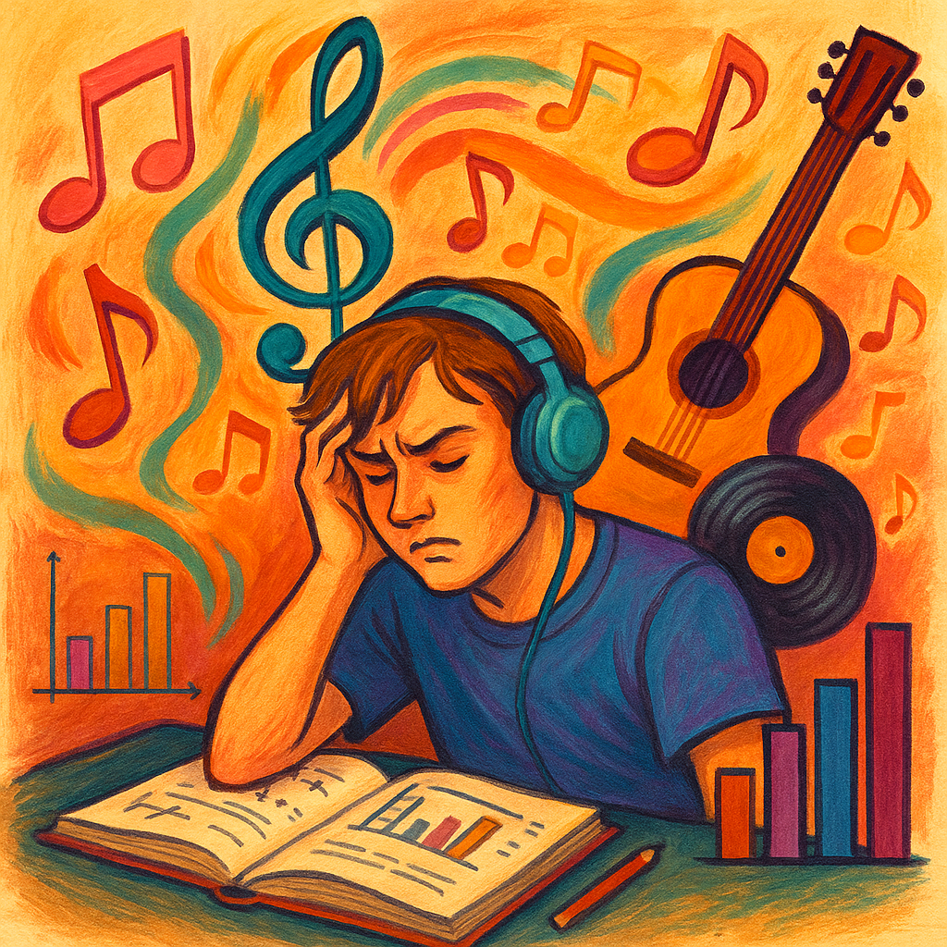
The Impact of Music Listening Habits on Academic Performance and Stress Levels
Ninerlytics
Brielle Boling, Joe Flucus, Keon Herring, Jaden Smith, & Hannah Wood
INFO 3237-090 Professor Berg April 20th, 2025

Slide 2
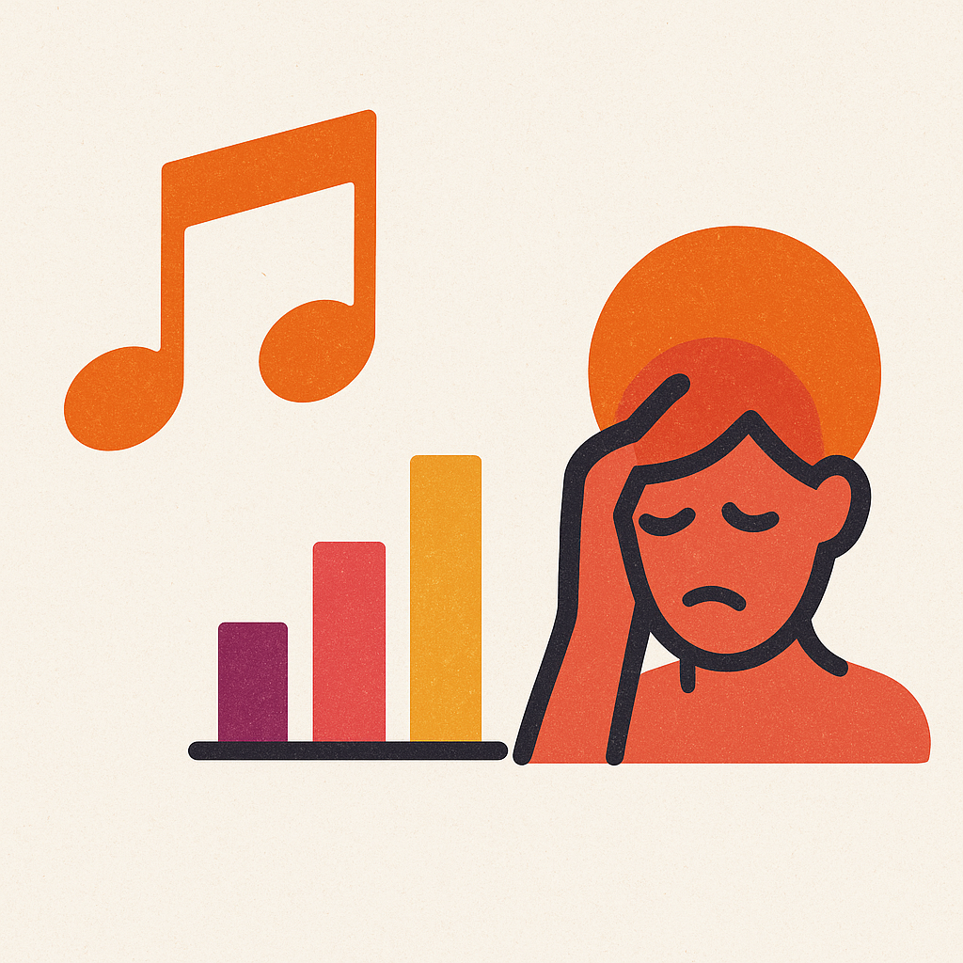
How do music habits impact the academic performance and stress levels of STEM and Business students?
Notes:
Keon
This topic is important and relevant to us as this is a Business Analyst Capstone at the bcob. The findings relate directly to us and can be used

Slide 3
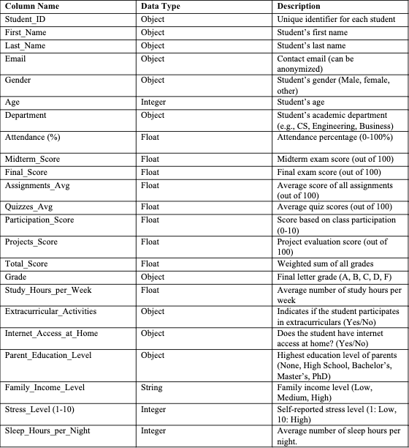
Data Dictionary - Student Performance Dataset
Notes:
Keon– mention where we found the data from too – using kaggle
Introduction of the student performance dataset:
Here we can use the time to mention step 4 of the potential outline: how we define ‘student performance/grade’, and ‘stress levels’
Student performance/grade: letter grades on a 10pt scale (ex. 90-100 is an A)
Stress levels: self-reported levels ranked 1-10
Age_y – to be traditional college level ages

Slide 4
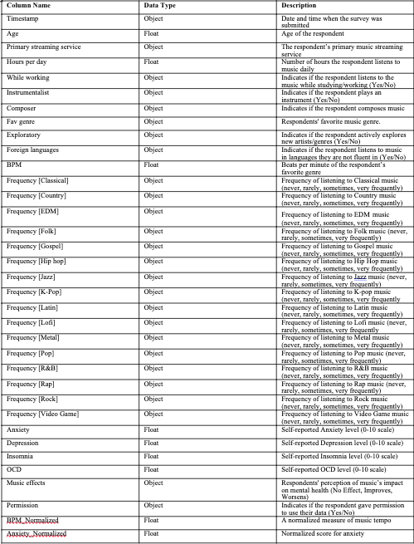
Data Dictionary - Music & Mental Health Dataset
Notes:
Keon: introduction of the dataset & mention where the data is from
How we define ‘music habits’ and ‘stress levels’
Music habits:
number of hours per day that one listens to music
If they listen to music while working or not
Favorite genre to listen to
Frequencies of each genre
Beats per minute
Stress levels: self reported levels ranked 1-10

Slide 5
Merging and Cleaning the Data
The Merge:
Merges by matching row indices
Cleaning:
Missing Values
Encoded Categorical Variables
Normalization + Standardization
Filtering Ages
Imputed median for numerical attributes
Imputed mode for categorical attributes
Winsorized to handle extreme attributes
Ensures all attributes are measured on similar scale
Assigned numbers to responses for data to be read as numerical
Only included ages 18-25
Notes:
Keon – briefly explain how we merged, and cleaned the data

Slide 6
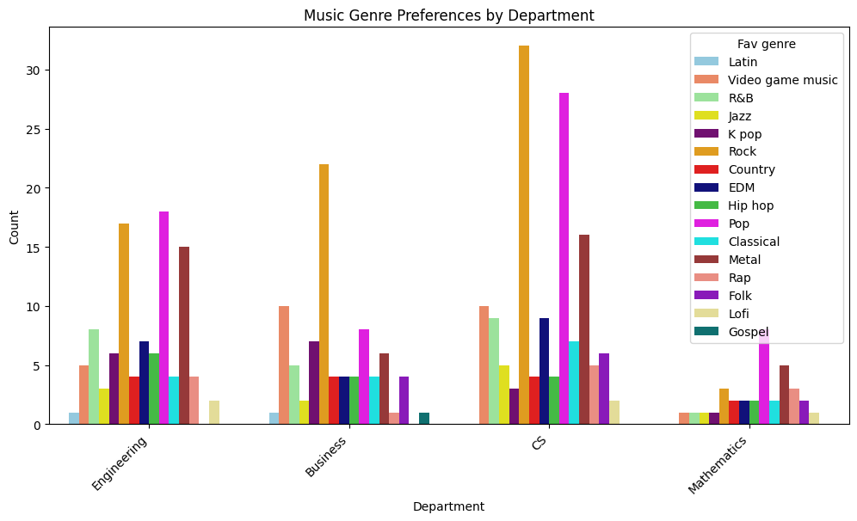
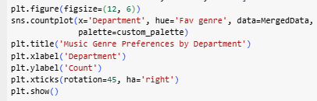
Exploratory Data Analysis
Top Genre Preferences:
Engineering: Pop
Business: Rock
CS: Rock
Mathematics: Pop
Notes:
Jaden
Let's begin by looking at music genre preferences across different academic departments. This chart shows the most popular music genres among students from four departments: Engineering, Business, Computer Science, and Mathematics. Overall, Rock and Pop are the top choices—especially in the Computer Science department, where over 30 students prefer Rock. CS students also had the most diverse music tastes. Engineering students favored similar genres, while Business students had more evenly spread preferences. Math students had the fewest responses, but Pop was the most popular there. Less common genres like Latin, Jazz, Gospel, and Folk were chosen less frequently across all majors. Interestingly, high-energy genres like Rock and Metal were more common in STEM fields, possibly reflecting the intense nature of those programs. Business students' broader genre variety might reflect more cultural diversity.

Slide 7
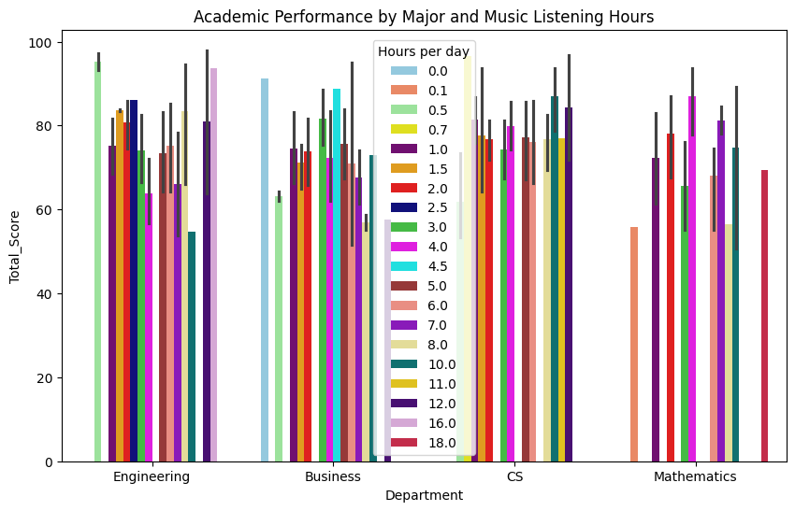
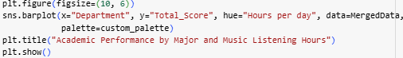
EDA Continued.
The longer the black line the more variance there is signifying outliers which may misrepresent the true average
Notes:
Jaden – shorten
Now, we'll explore the connection between academic performance and music listening habits. This chart plots students' total scores against the number of hours they listen to music daily, categorized by their major: Engineering, Business, CS, and Mathematics. We found that students who listen to music for a moderate amount of time—about 0.5 to 2.5 hours per day—tend to have higher scores, especially in Engineering and CS. CS students actually performed well across nearly all listening durations. However, students who listened for 10 or more hours per day had more mixed or lower scores, especially in Business and Math. So, while moderate listening may support academic success, excessive listening might hurt it—but not always. Some students still scored high, which shows that personal habits and study styles can vary. It is important to note that in this graph there may be a black line per colored bar. The black line signifies variance in the this section of data. Meaning the longer the black line the more variance or outliers which may misrepresent the true average.

Slide 8
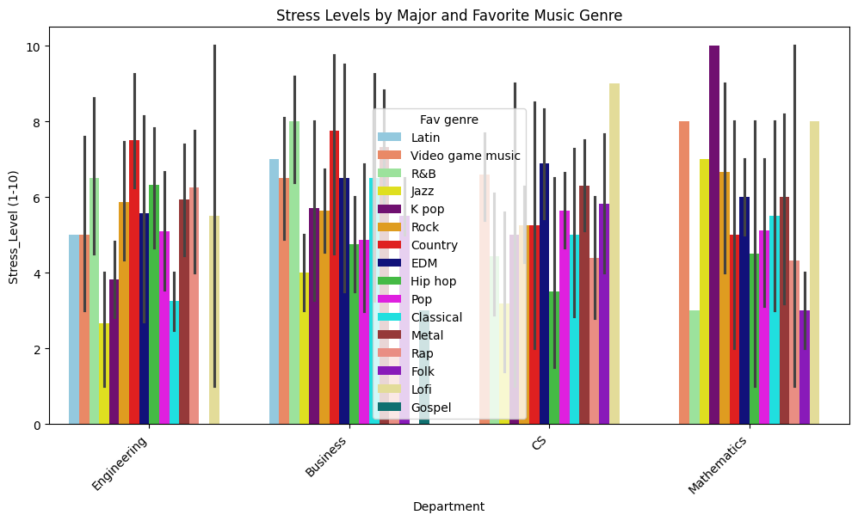
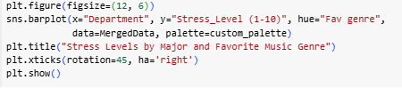
EDA Continued.
Each bar represents a group of students who share the same major and musical preference, with the color of the bar indicating the genre. thin black lines represent 95% confidence intervals, which reflect uncertainty in self reported stress levels.
Notes:
Jaden-
Finally, let's examine stress levels in relation to major and music genre preference. This bar chart explores average student stress levels (rated from 1 to 10) based on their academic department—Engineering, Business, or Mathematics—and favorite music genre. Each colored bar represents a specific group, while the thin black lines show 95% confidence intervals, indicating how certain we are about each group's average. Taller bars mean higher stress, and shorter confidence intervals suggest more reliable estimates. For example, Mathematics students who prefer K-pop report the highest stress level (a 10) with a narrow confidence interval, pointing to both high and consistent stress in that group.
Across the departments, some trends stand out. Engineering majors who enjoy K-pop, Rock, or Video Game Music tend to report higher stress, while those who favor Classical or Lo Fi music show lower stress. Business students who prefer Jazz or Classical also report lower stress on average, while fans of Metal or R&B show higher levels. These patterns suggest that both academic major and music preference may influence perceived stress, though individual experiences vary, and these findings reflect group averages—not personal outcomes. The chart provides a starting point for deeper analysis and reminds us that data always includes some level of uncertainty.

Slide 9
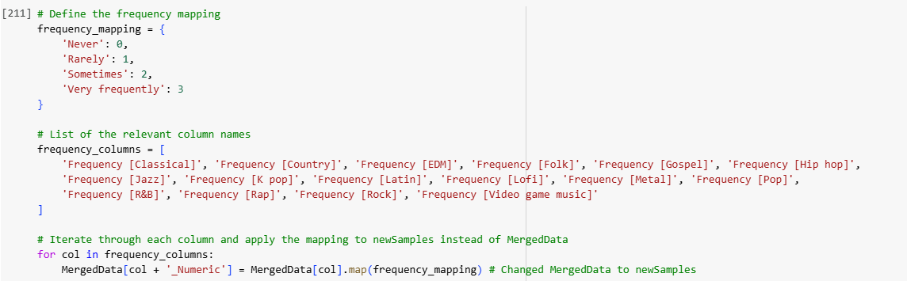
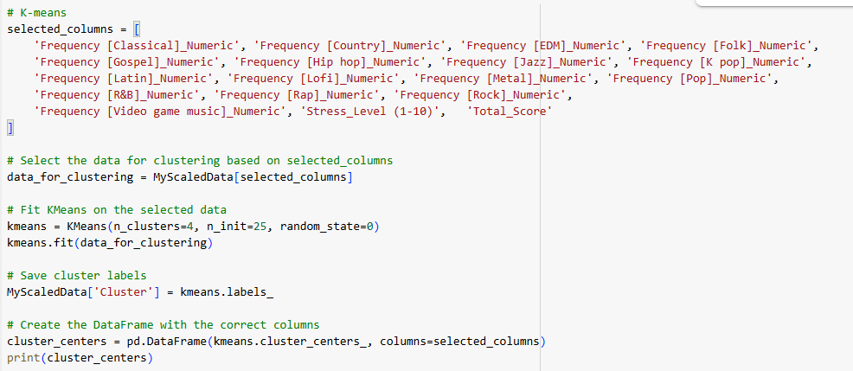
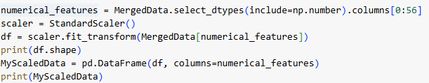
Code for Clustering
Notes:
Joe
We wanted to cluster our merged dataset to develop a deeper understanding of the relationships in the data
By grouping students based on patterns across these three categories, we gain valuable context to support later findings and establish a stronger framework for exploring our research question
Music Habits
Mental Health Indicators
Academic Performance

Slide 10
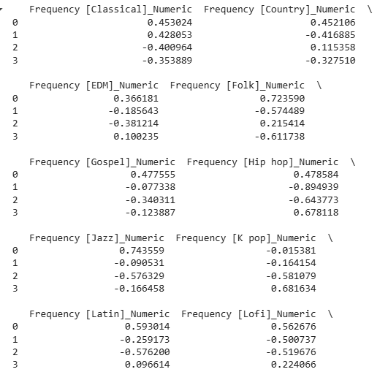
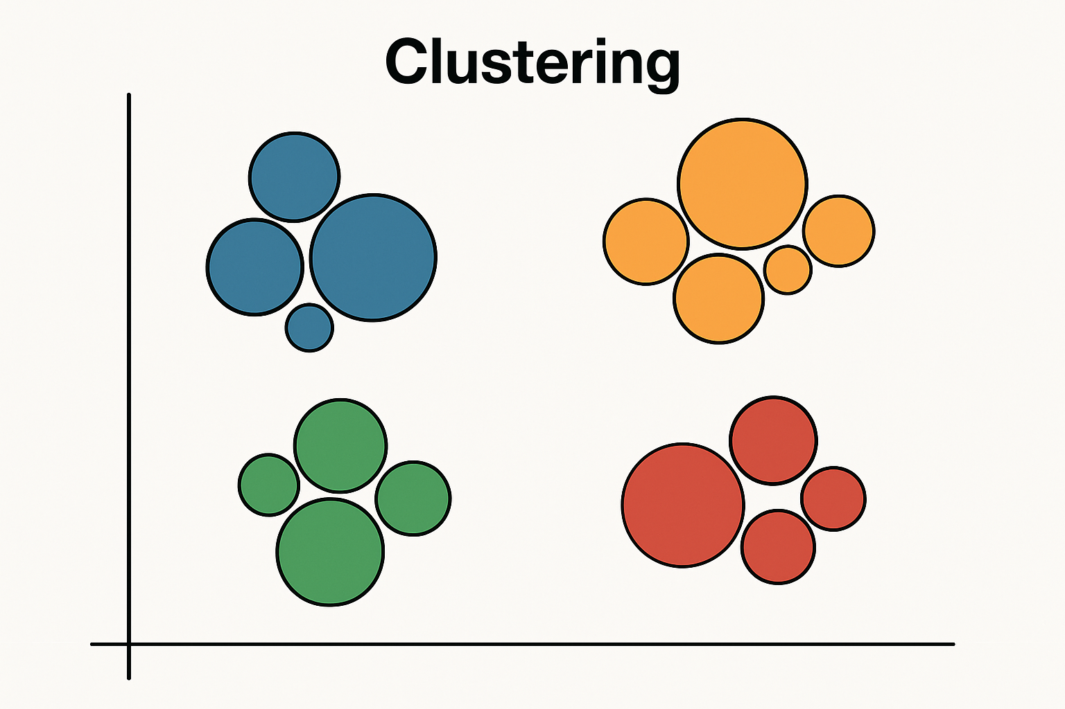
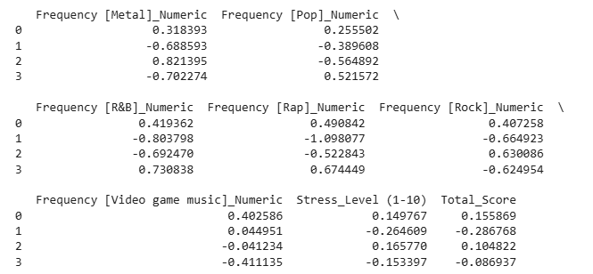
Clustering: The Output
Clustering output

Slide 11
Clustering: Findings
Music Genre, Stress, and Academic Score Frequency Ranking
Index | Classical | Country | EDM | Folk | Gospel | Hip Hop | Jazz | K - Pop
0 | 1 | 1 | 1 | 1 | 1 | 2 | 1 | 2
1 | 2 | 4 | 3 | 3 | 2 | 4 | 2 | 3
2 | 4 | 2 | 4 | 2 | 4 | 3 | 4 | 4
3 | 3 | 3 | 2 | 4 | 3 | 1 | 3 | 1
Stress Level
2
4
1
3
Total Score
1
4
2
3
Latin | Lofi | Metal | Pop | R&B | Rap | Rock | VGM
1 | 1 | 2 | 2 | 2 | 2 | 2 | 1
3 | 3 | 3 | 3 | 4 | 4 | 4 | 2
4 | 4 | 1 | 4 | 3 | 3 | 1 | 3
2 | 2 | 4 | 1 | 1 | 1 | 3 | 4

Slide 12
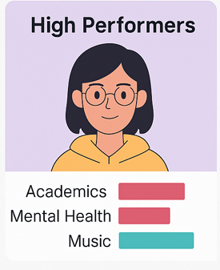
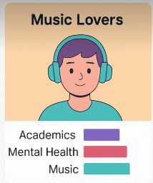
Clustering: Interpretations
Cluster 1:
Lower engagement across the all of the music genres, they have the least amount stress but the the worst academic performance as well
Cluster 3:
Top ranked in Hip Hop, R&B, Rap, and K - Pop, they are 2nd lowest in stress and also second lowest in academic performance.
Cluster 2:
Also has lower engagement then the other groups but they rank highest in Metal and Rock. They are the highest and stress and the second highest in academic scores
Cluster 0:
Higher engagement across most genres with their top being in Classical, Jazz and Lofi amongst several others. They have the second highest stress and the highest total tcore

Slide 13
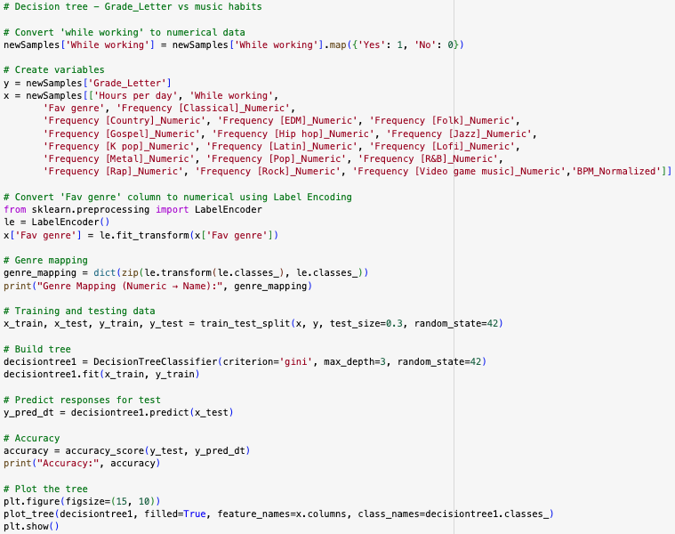
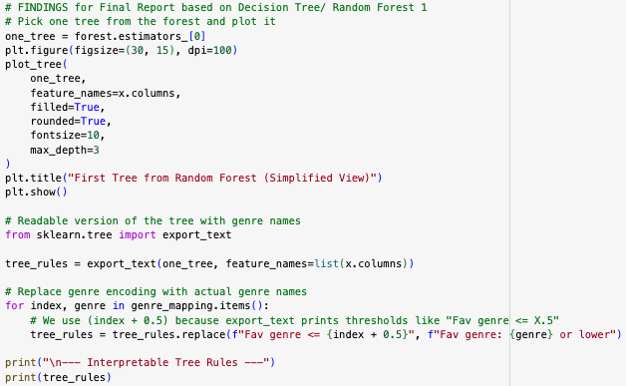
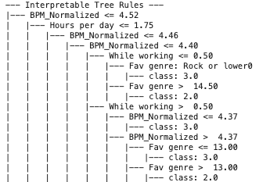
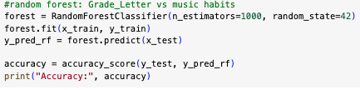
Random Forest #1: Music Habits & Academic Performance
Building
Displaying the Results
Notes:
Brielle

Slide 14
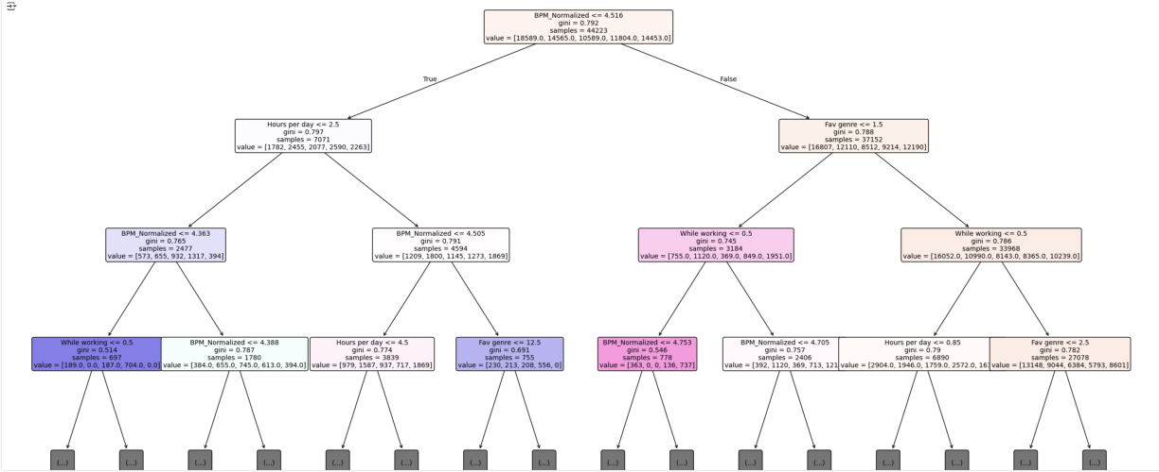
Random Forest #1: Music Habits & Academic Performance
First tree from forest
Accuracy:
94.78%
Feature Importance:
Daily Listening Duration
Beats per minute
Preferred Genre
Y = Letter Grade
X = Music Habits
Notes:
Brielle
To identify most important predictors of academic performance and stress levels based on music habits
Enhances our accuracy with reduced overfitting

Slide 15
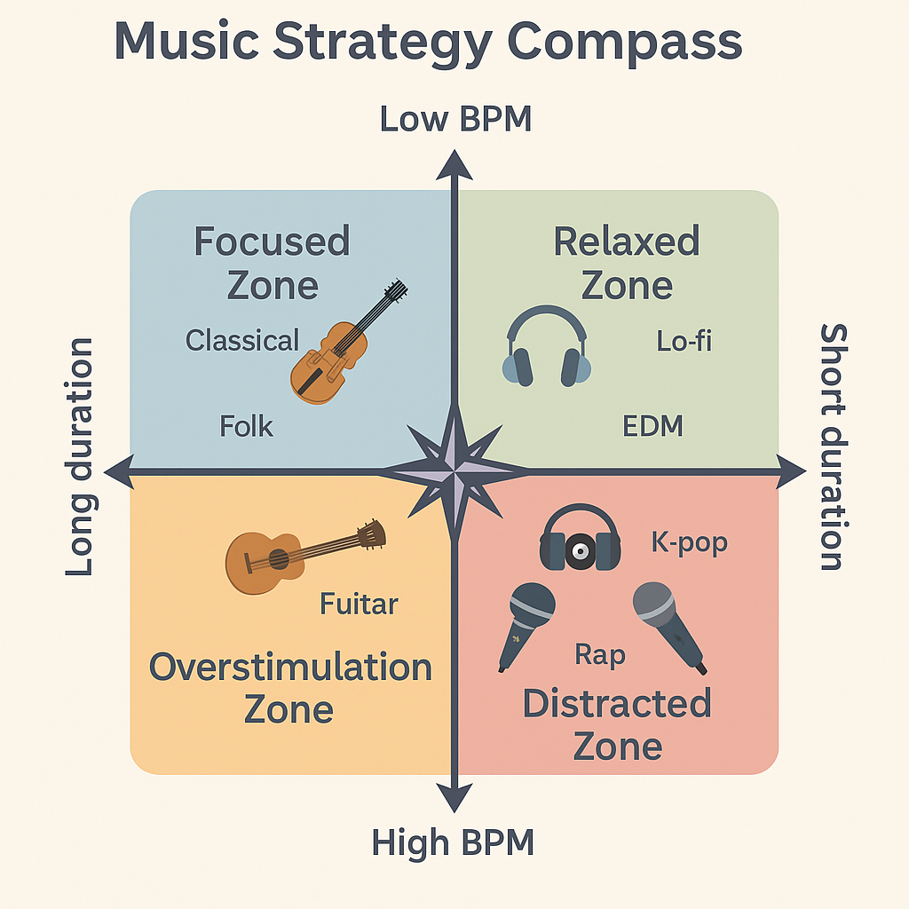
Music Habits and Academic Performance Findings
High Performing Students (A/B Grades)
Listened to music ≤ 1.75 hrs/day
Preferred low beats per minute genres
Classical, Lo-fi, Jazz
Country
Lower Performing Students (C/D/F Grades)
Listened to music ≥ 1.75 hrs/day
Preferred high beats per minute genres
EDM, K-pop, Rock
Metal
Generated by ChatGPT
Notes:
Brielle

Slide 16
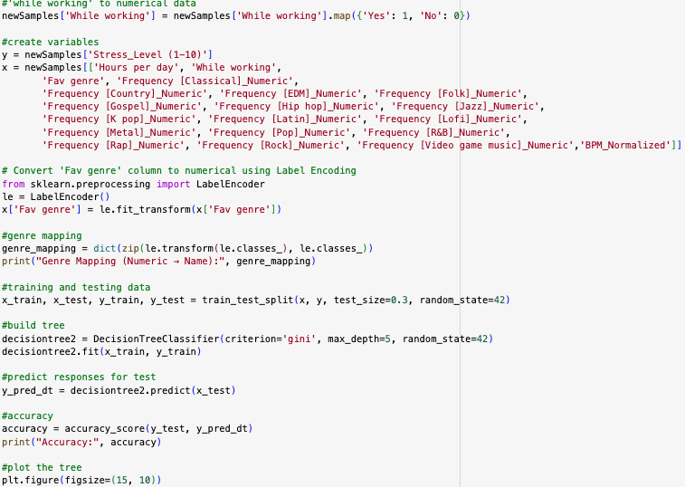
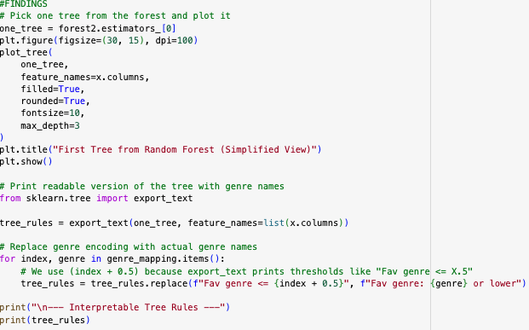
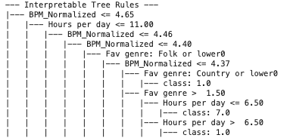
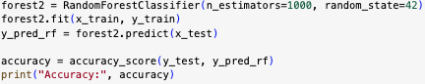
Random Forest #2: Music Habits and Stress Levels
Building
Displaying the Results
Notes:
Brielle

Slide 17
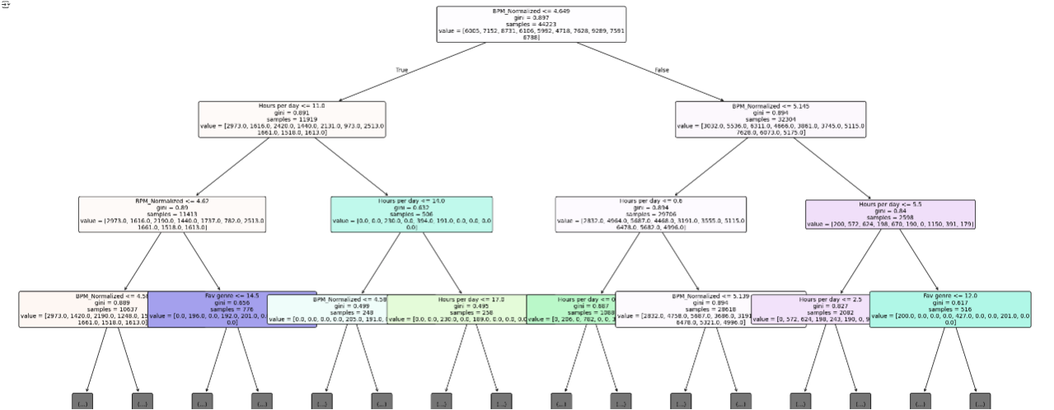
Random Forest #2: Music Habits and Stress Levels
First tree from forest
Feature Importance:
Beats per minute
Preferred Genre
Daily Listening Duration
Listening While Working
Accuracy:
91.1%
Y = Stress Levels (1-10)
X = Music Habits
Notes:
Brielle

Slide 18
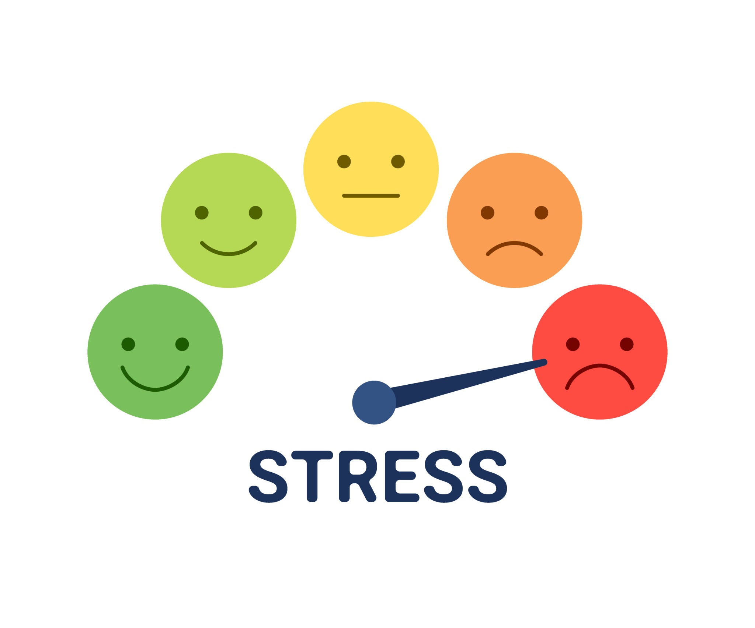
Music Habits and Stress Levels Findings
Beats Per Minute (BPM)
Low BPM = low stress
High BPM = elevated stress
Daily Listening Duration
1-1.25 hrs/day = low stress
3.5-4.5+ hrs/day = increased stress
Music While Working
Task-appropriate
Low Stress
Not task-appropriate
High Stress
Indie
Pop
R&B
Folk
K-Pop
Country
Lofi
Electronic
Jazz
EDM
Classical
Gospel
Metal
Notes:
Brielle

Slide 19
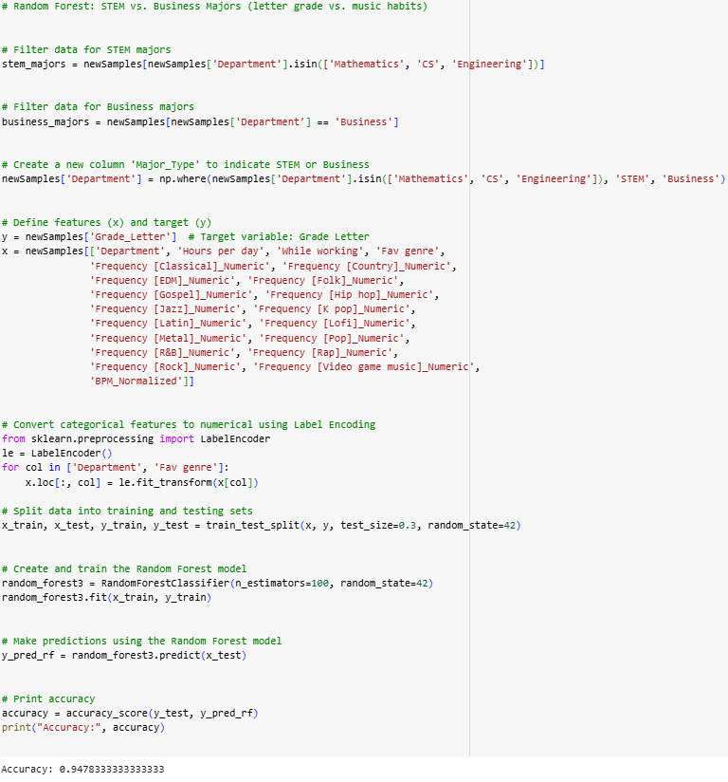
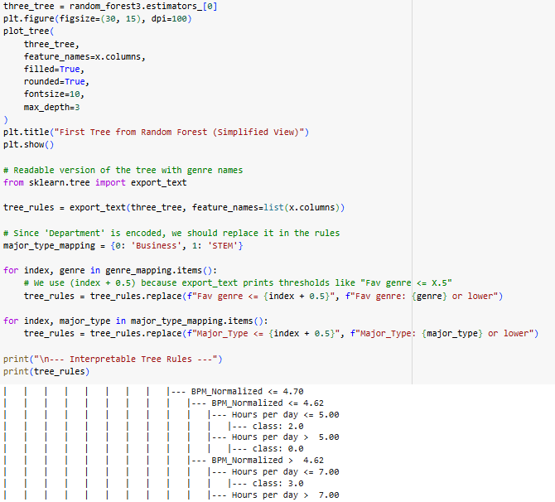
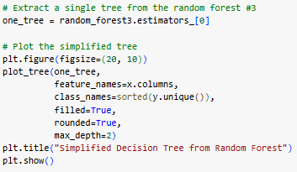
Code for random forest #3
Notes:
Hannah

Slide 20
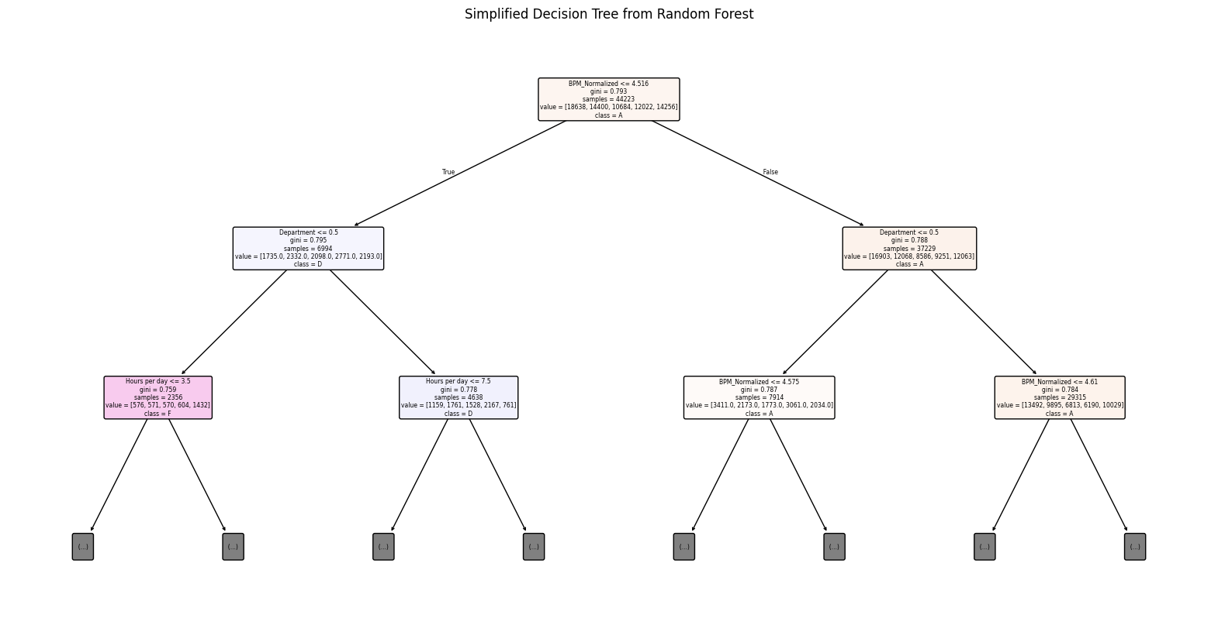
Random Forest # 3: STEM vs Business
Features & Target:
Feature Importance:
Beats per minute
Preferred Genre
Daily Listening Duration
Department
Y = Grade Letter
X = Department, Hours per day, While working, Fav genre, BPM_Normalized
Frequencies of 16 genres
Accuracy:
94.91%
Notes:
Hannah
Interpreting the Confusion Matrix (Random Forest)
The confusion matrix breaks down how well the model predicted each letter grade (A–F) compared to the actual grade.
Each row = Actual Grade Each column = Predicted Grade
✅ What Went Well:
High accuracy in correct classifications:
7381 students who actually earned an A were correctly predicted as A.
5974 students with a B were correctly classified.
5056 students with a D, and 5599 students with an F were also correctly predicted.
These high values along the diagonal show the model is performing very well.
🔁 Small Misclassifications:
Minor confusion between A and nearby grades:
183 students who got an A were predicted as B
166 predicted as F
141 predicted as D
This might reflect borderline scores or overlapping features (e.g., similar music habits or study behaviors).
F and A overlap:
357 students who actually received an F were predicted as A — this is notable and may indicate that certain behaviors (e.g., high listening time, favorite genre) appear similar between top and struggling students.
Very few predictions for grade C:
Nearly all correct predictions for C (4463), but almost no confusion into/out of this category, which might suggest a clearer pattern for C students.
📌 Takeaway:
The model does an excellent job distinguishing between most grades, especially A, B, D, and F.
Some overlap between adjacent grades (e.g., A↔B, D↔F) is expected and reflects the complexity of academic performance, which can’t always be perfectly separated by habits or major.
Overall, the confusion matrix supports the high accuracy of 94% and shows that the Random Forest is highly reliable.

Slide 21
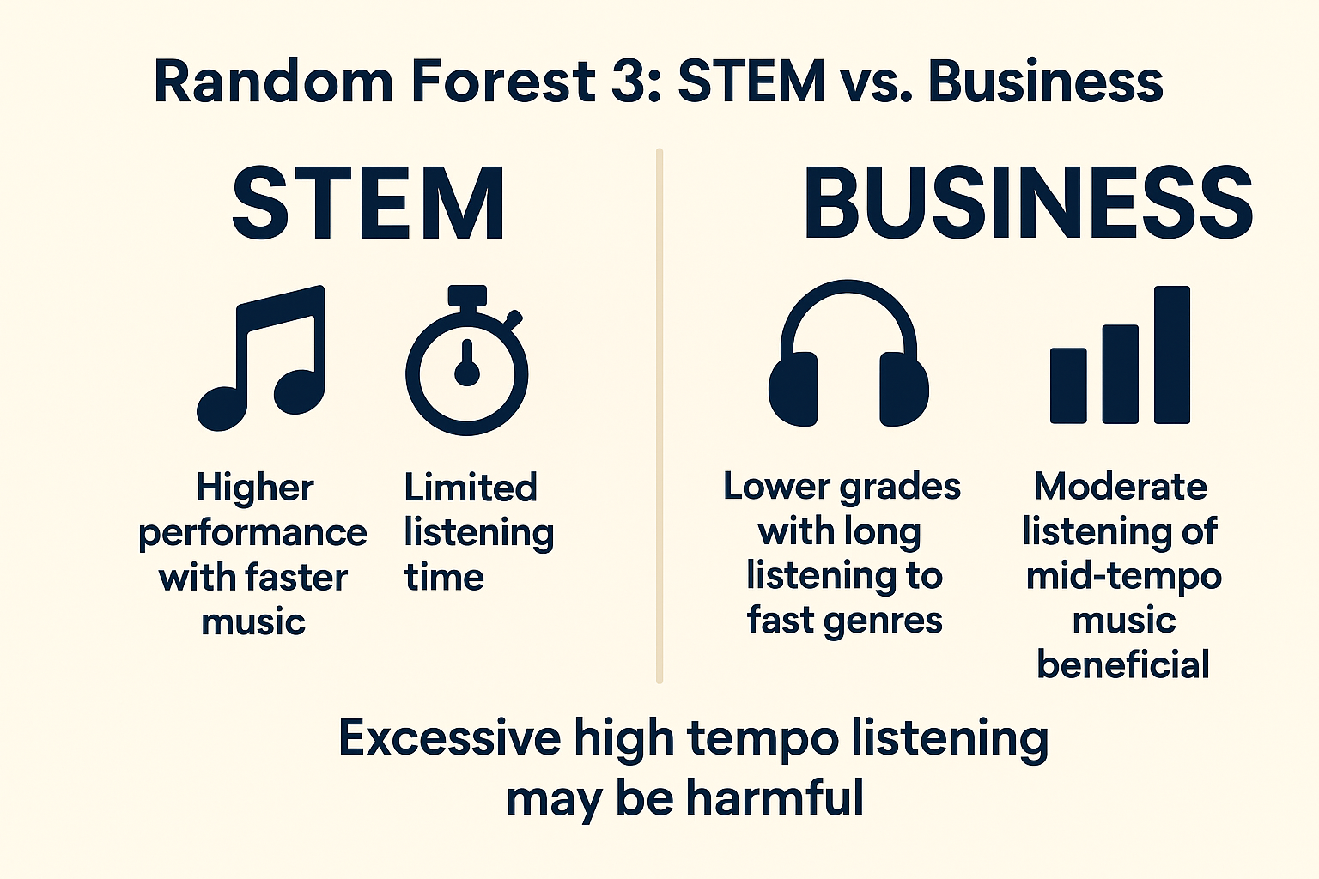
STEM vs Business Findings
Major Differences
Business- perform better with mid-tempo genres (Pop/Latin) & structured listening (1.5-3.5 hrs/day)
STEM- High BPM with engaging genres & shorter listening times → higher grades
Conclusion
Tempo matters MOST
High BPM + long exposure = lower performance
Moderation + genre choice = key to academic performance
Key Patterns
Lower BPM → higher grades (A/B)
Moderate listening (1.5-3.5 hrs/day) → boosts academic performance
High BPM + excessive listening (>9 hrs/day) → lower grades (D/F)
Generated by ChatGPT
Notes:
Hannah
Students who listen to slower or moderate tempo music tend to perform better overall

Slide 22
Recommendations
01
02
03
04
Be Intentional with Genre Choice
Limit Listening Time
Match Music to the Task
Create Structured Listening Routines
Low-BPM & instrumental genres (Classical, Lo-fi, Jazz, Gospel) → Lower stress, higher grades
High-BPM genres (EDM, Metal, Hip Hop) → Use during non-study times to avoid overstimulation
Optimal: 1–3 hours/day → Better academic performance, lower stress
Avoid: >4 hours/day → Correlated with lower grades and higher stress
Study sessions → Calming, instrumental music
Breaks/workouts → High-energy music okay
Avoid high-BPM during complex academic work
Use specific playlists for studying or relaxation
“Focused Listeners” had best mental health and academic results
Notes:
Jaden
Based on our analysis using cluster and Random Forest models, we found clear links between music habits, academic performance, and stress levels. One key takeaway is that genre matters—students who listened to calming music like Classical, Lo-fi, Jazz, and Gospel tended to have lower stress and better grades. In contrast, high-energy genres like EDM, Metal, and Hip Hop were linked to higher stress and lower academic performance, especially when used during study time. So, it’s helpful to save those upbeat tracks for workouts or breaks rather than study sessions.
We also found that moderation and timing are important. Students who listened to music for about 1 to 3 hours a day generally performed better and felt less stressed. But listening for more than 4 hours daily often showed the opposite effect. Creating structured habits—like having specific playlists for studying or relaxing—can make a big difference. In short, music can be a helpful tool for managing stress and boosting focus, as long as it’s used intentionally and in the right context.
Given that we are business students in a digital age these findings can be extremely useful as we transition to finals and for some graduate education after, we may choose to lower BPM listening options for more structured listening routines.

Slide 23
References
Elhemaly, M. (n.d.). Students grading dataset. Kaggle. Retrieved March 23, 2025, from
https://www.kaggle.com/datasets/mahmoudelhemaly/students-grading-dataset
Rasgaitis, C. (n.d.). MXMH survey results. Kaggle. Retrieved March 23, 2025, from
https://www.kaggle.com/datasets/catherinerasgaitis/mxmh-survey-results

